Slide 1
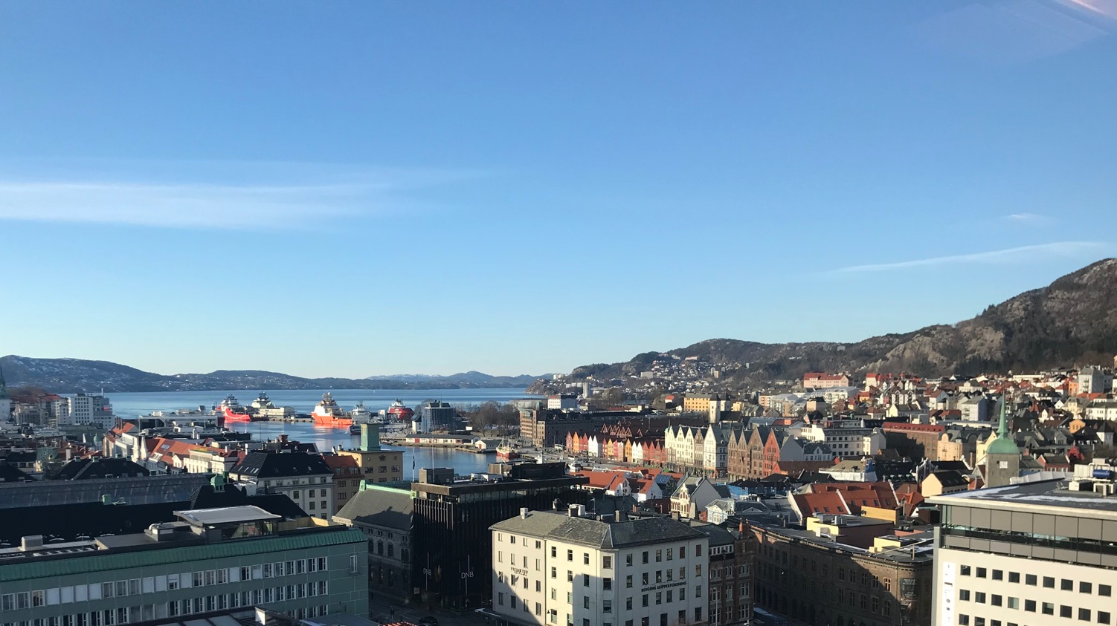
Towards diabetes cell therapy
Helge Ræder MD PhD
Professor, University of Bergen, Norway
Senior Consultant, Department of Pediatrics, Haukeland University Hospital

Slide 2
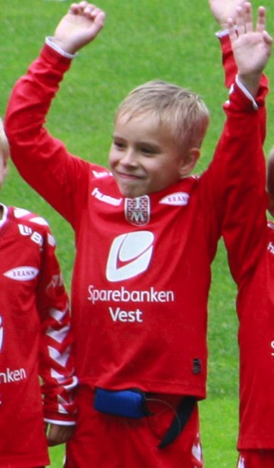
Phillip
Notes:
Autotransplantasjon behandlingsmulighet for alle diabetesformene.
Vi vil selvfølgelig ikke at nye beta celler skal ødelegges når de auto-transplanteres:
For type 1 diabetes må betacellene kapsles inn for å unngå immunangrep
For type 2 diabetes er det bare å fylle på.

Slide 3
Phillip
Notes:
Autotransplantasjon behandlingsmulighet for alle diabetesformene.
Vi vil selvfølgelig ikke at nye beta celler skal ødelegges når de auto-transplanteres:
For type 1 diabetes må betacellene kapsles inn for å unngå immunangrep
For type 2 diabetes er det bare å fylle på.

Slide 4
Diabetes stem cell treatment options
Cell therapy with limited source
  Pancreas tx
  Islet tx (Edmonton-protocol)
Cell therapy with unlimited source
  Autologous: hESC-based cell therapy
  Allogenic: iPSC-based cell therapy
  Xenogenic: Porcine islets
MSC-based immune modulatory treatment
Gen therapy: Repurposing of alpha cells->beta cells

Slide 5
Diabetes stem cell treatment options
Cell therapy with limited source
  Pancreas tx
  Islet tx (Edmonton-protocol)
Cell therapy with unlimited source
  Autologous: hESC-based cell therapy
  Allogenic: iPSC-based cell therapy
  Xenogenic: Porcine islets
MSC-based immune modulatory treatment
Gen therapy: Repurposing of alpha cells->beta cells

Slide 6

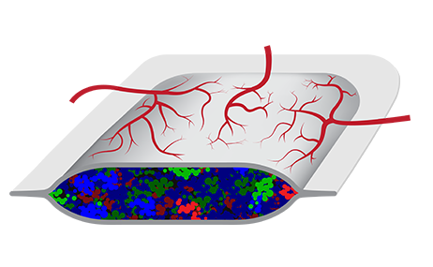
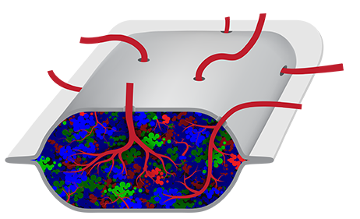
Diabetes cell therapy challenges
A. Developing functional cells and avoiding side effects (tumor growth)
B. Avoiding immune attach
Avoid alloimmune response - rejection
Avoid autoimmune response
Capsule
C. Enure retrival/replacement of the cell therapy product
Encapsulation strategies
Encapsulation site
D. «Google patent publishing»

Slide 7
Diabetes cell therapy challenges
A. Developing functional cells and avoiding side effects (tumor growth)
B. Avoiding immune attach
Avoid alloimmune response - rejection
Avoid autoimmune response
Capsule
C. Enure retrival/replacement of the cell therapy product
Encapsulation strategies
Encapsulation site

Slide 8
Paradigm: Induced pluripotent stem cells (iPSCs)
Reprogramming
Directed differentiation
iPSCs
Differentiated cell (skin, gut)
BETA-LIKE CELLS

Slide 9
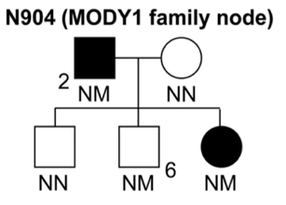
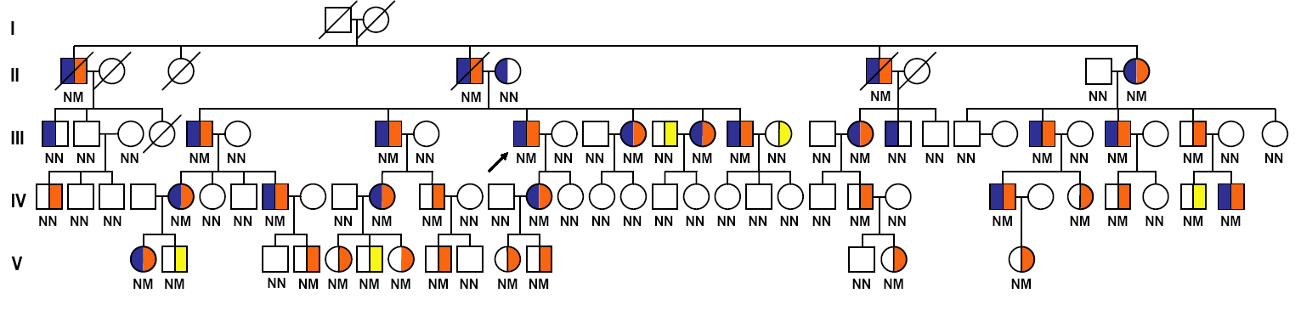
MODY-hiPSCs as the basis for stem cell derived beta cells
N64: P291fsinsC
N5:
Δ
R137-K161
N97: R2229Q
N61: IVS5+1ntG>C
N318: A276D
N73: P447L
Maturity-Onset Diabetes of the Young
Permanent Neonatal Diabetes Mellitus
AD or AR inheritance
MODY Registry since 1998
CEL-MODY (MODY8)
GCK-PNDM
SU in KCNJ11-PNDM
N528: W340X
N1: P291fsinsC
N69: P291fsinsC
N75: P291fsinsC
N7: R131W
N13: R131W
7
1
N14: R131W
N94: 131W
N334: P112L
N40: R271W
p.Ile271fs
N66: P379fsdelCT
N87: P379fsdelCT
N79: Y215X
N346: P112L
N18: Q466X
N511: G326R
N74: R229Q
N91: V255M
N24: L146R
N49: R229Q
N557: V255M
N337: R229Q
N515: P2-50
N6: P291fsinsC
N82: S445fsdelAG
N28: P291fsinsC
N19: S256T
N88 : P2-192
N29: P291fsinsC
N98: S531T
N510 : P2-192
N26: P291fsinsC
1085 families: 123 with MODY3, 93 with MODY2, 13 with MODY1, 22 with MODY5
N8: R263C
N327: IVS3-1 G-A
N23: G47E
N3: R171X
N84: P291fsinsC
N27: R131W
N78: E339G
N107: M522V
N9: P112L
N81: R275C
N2: V62A
N96: T196fsdelCCAA
N332: P112L
N83: R377C
N17: M210K
N333: P112L
N37: T339I
Ræder et al, Nat Gen, 2006
Njølstad et al, NEJM, 2001
Diabetes
Pancreatic exocrine dysfunction
Sagen, Ræder et al, Diabetes, 2004
Notes:
First, I am grateful to the organizers for the invitation to this wonderful meeting and for the nice introduction.
The basis of our studies: MODY Registry
Research highlights include---
Murine models discouraging, turned to iPSC-based models
We focus on families, having both pre-diabetic and diabetic mutation carriers.

Slide 10
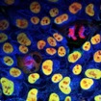
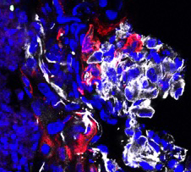

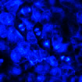
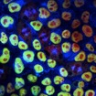
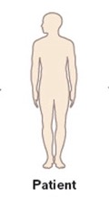
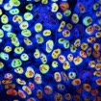
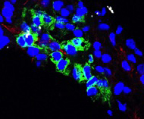
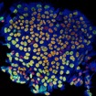
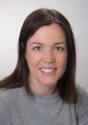
Episomally reprogrammed iPSC are pluripotent
Teratom-assay
Reprogramming
oct4
sox2
a-tubulin
overlay
N904-1e
N904-1
diabetics
TUJ1 (ektoderm)
N904-2
SMA (mesoderm)
mutation carrier
N904-6
7
1
AFP (endoderm)
p.Ile271fs
normal sibling
N904-7
Episomal reprogramming
Bjørlykke et al, Stem Cell Int, 2019
Okita et al, Nat Met, 2011
Episomal transfection
(500.000 cells)
Culture
(30.000 cells/well)
Colony picking
DMEM-LG/FBS
ESC medium and bFGF
Dag: 0 5 7 20-40
Notes:
So let us focus in on the MODY1 family, from which we have studied a quadro of 4 people.
We reprogrammed fibroblasts from these subjects with episomal reporgrmaming and confirmed pluripotency with embryoid body formation.
We used the Rezania 2014 protocol to direct differentiation towards S7 cells.
Of the wide range of characterization methods used, we will here focus on proteomics methods.
With MODY samples we are interested in asking about mutation-specific differences in fate aquistiion or beta cell function.

Slide 11
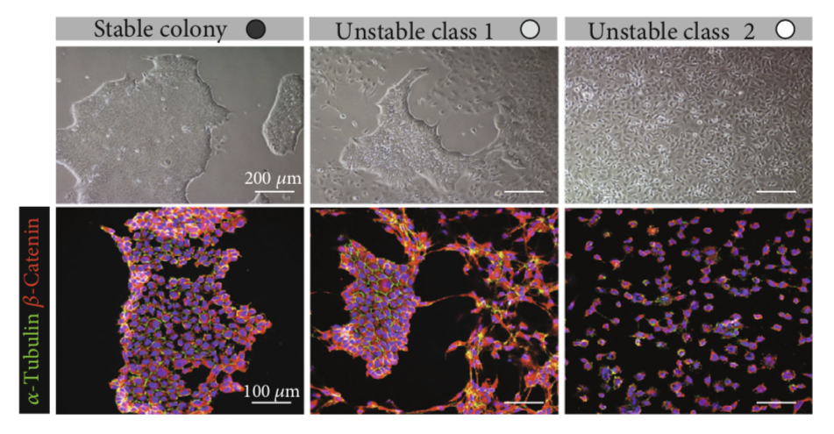
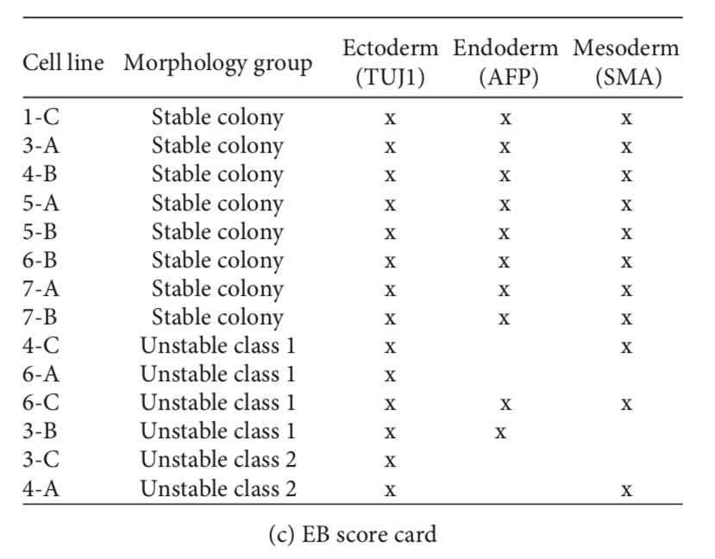
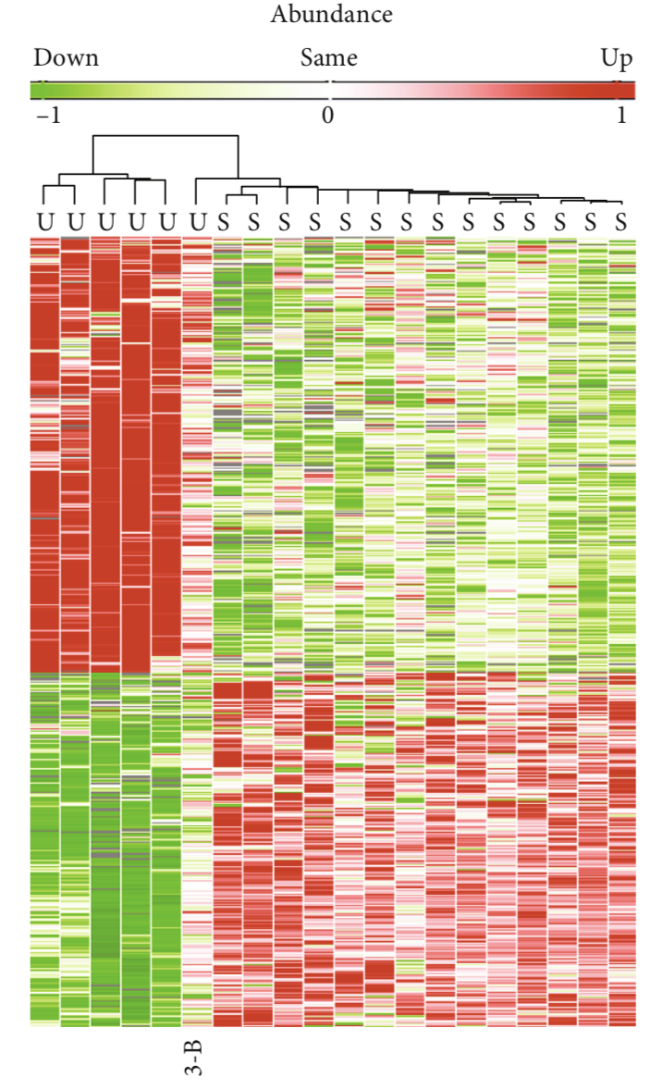
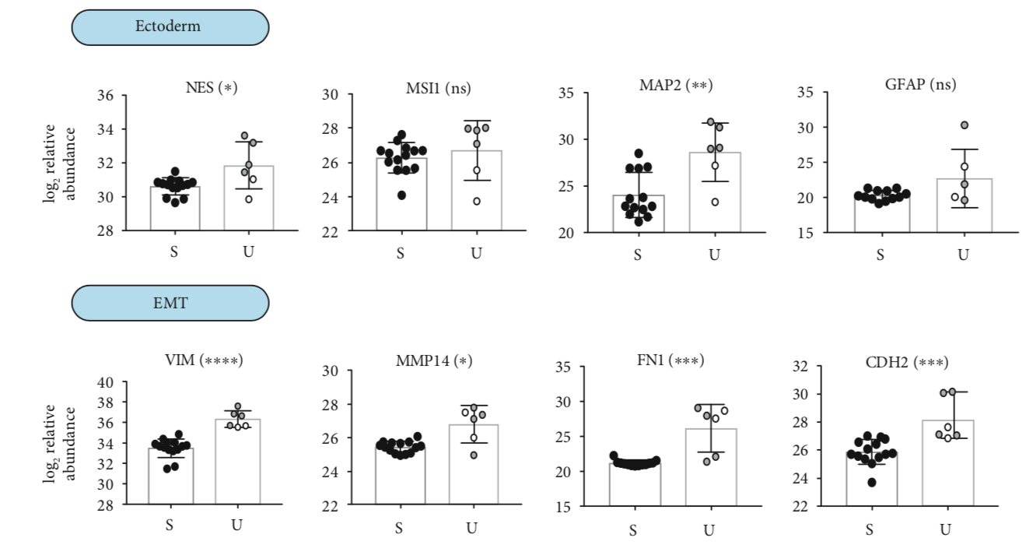
Reprogrammed cells are not equal
Pluripotency correlated with colony morphology
- Compact colonies
- Well defined edges
- Disintegrating
colonies
- No colonies
- Monolayer
Unique lobal proteomics signatures
EMT markers up in unstable colonies
Bjørlykke et al, Stem Cell Int, 2019
Unstable
Stable

Slide 12
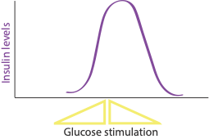

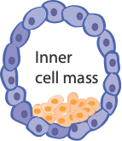
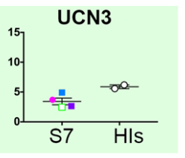
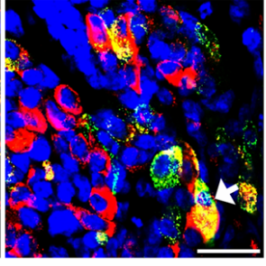



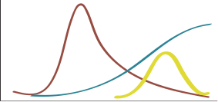
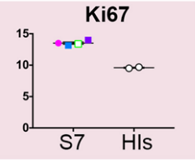
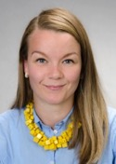
Mimicking embryogenensis is not straightforward
Directed differentiation
Functional cells?
Glucose Stimulated
Insulin Secretion test (GSIS)
Directing iPSCs into insulin-producing β-like-cells
β-cell protocol (∽1 month )
Mimic embryogenesis (∽9 month)
Endocrine precursors
ESCs
iPSCs
Definite endoderm
Pancreatic endoderm
Primitive gut tube
Posterior foregut
β-like cells
?
Ins
TGFB
SHH
TGFB
Glu
Canonical WNT
Modulate
Signalling
Pathways
Immature
β-cell
β-like cells
Bi-hormonal
Mono-hormonal?
Each stage: Specific combination of factors
In total: 16 stage-specific factors
Vethe, Bjørlykke et al, Sci Rep, 2019
Rezania et al., Nature Biotechnol (2014), Pagliuca et al., Cell (2014), Russ et al., EMBO J (2015), Vegas et al., Nat Med (2016)
Notes:
Mimic
Transplantation as part of the protocol.
Reversal of diabetes has been proven - so there is a good chance these cells will mature and reverse diabetes in humans as well.
Mimic embryogenesis and pancreas development
Stage 1-7 waves and then a mouse
Reversal in mice has been proven.

Slide 13
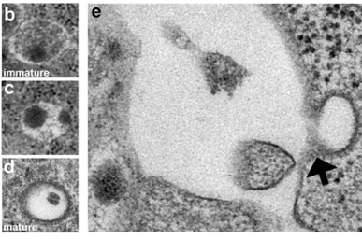
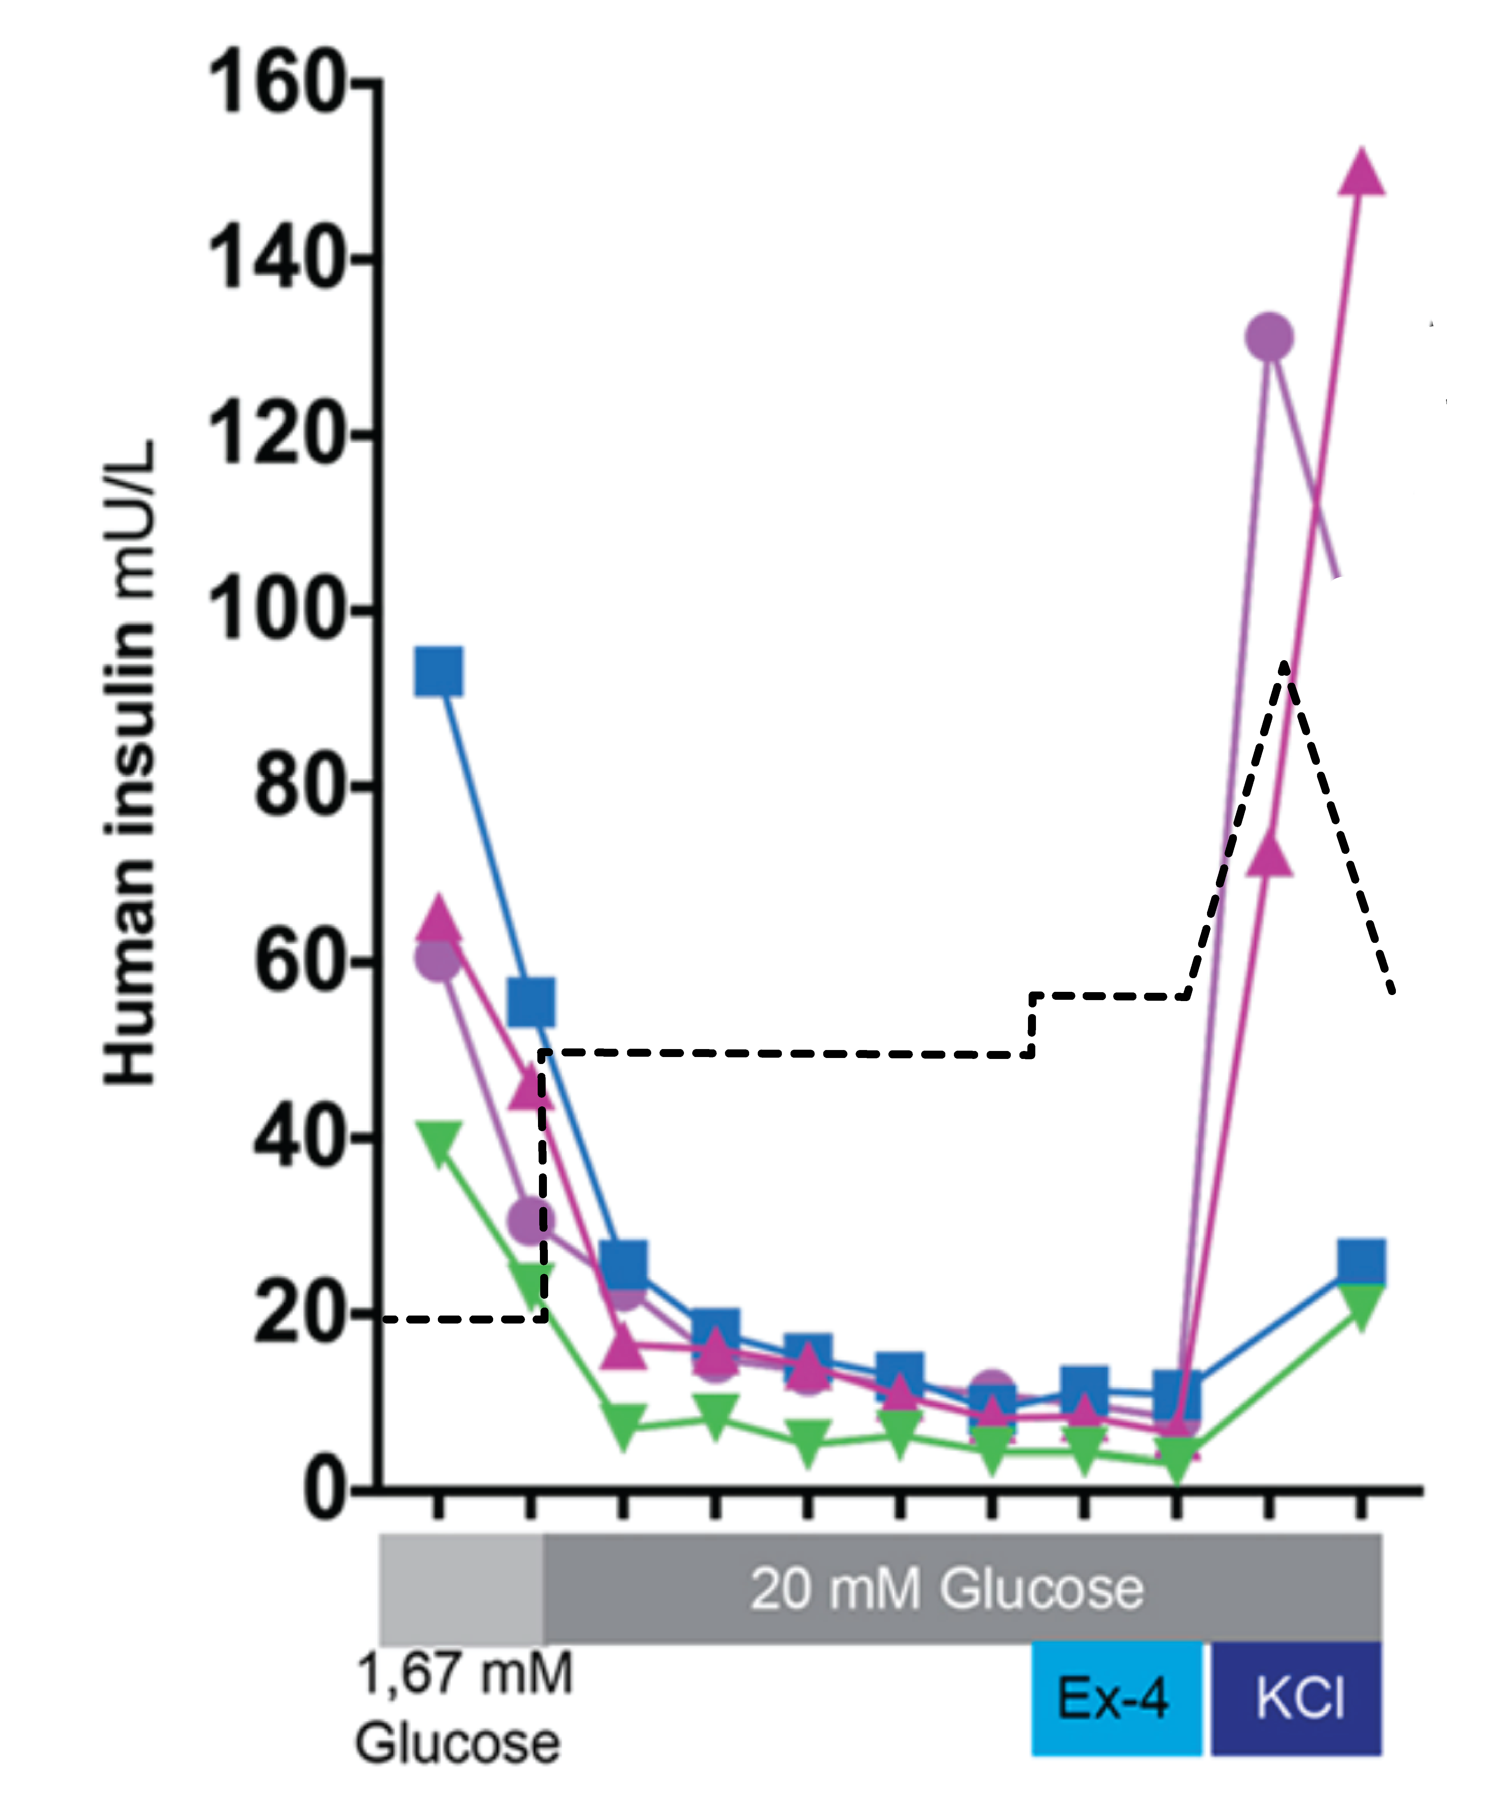
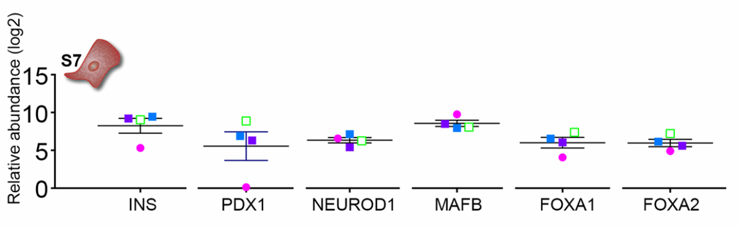
Pancreatic β -like cells but not functional
Actin (phalloidin)
NKX6.1
insulin
N904-7
normal sibling
mutation carrier
N904-6
Bi-hormonal cells
Increased Wnt/ β-catenin signaling
Vethe, Bjørlykke et al, Sci Rep, 2019
Notes:
Stage Metric Goal after Rezania/Honore Current report
7 Ins+/Nkx6.1+ >40% (email, 40%; 2014-paper, 10% by IF
but 10% if iPSC!)
Ins+/GCG- >43% (2014-paper) 57% by IF
Ins+/GCG+ <11% (2014-paper) 13% by IF

Slide 14
Wnt-inhibition increases mono-hormonality but not functionality
Vethe et al, Frontiers in Endocrinology, 2019

Slide 15
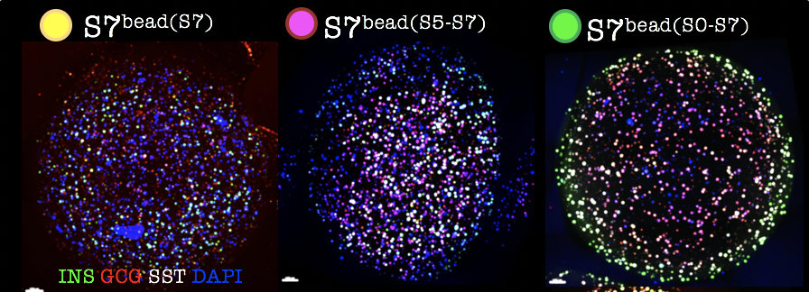
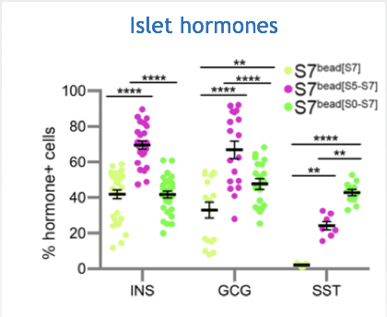
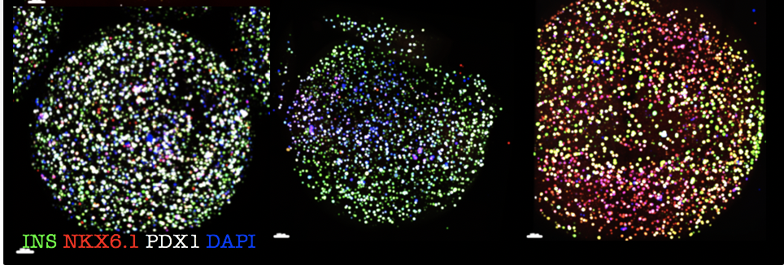
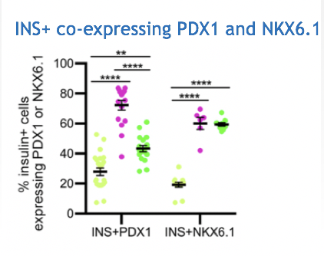
Alginate encapsulation promotes the expression key beta-cell markers and islet-like proteomic signature in vitro
Legøy, Vethe et al, Sci Rep, 2020

Slide 16
Hyperglycemia inhibits expression of key beta cell markers in vivo
I wk post tx
4 wks post tx
Vethe, Legøy et al, Acta Physiol, 2019
Notes:
Hyperglykemi (4 uker) motvirker uttrykk av betacellemarkører etter xenotransplantasjon av alginatkledde hIPSC-betaceller

Slide 17
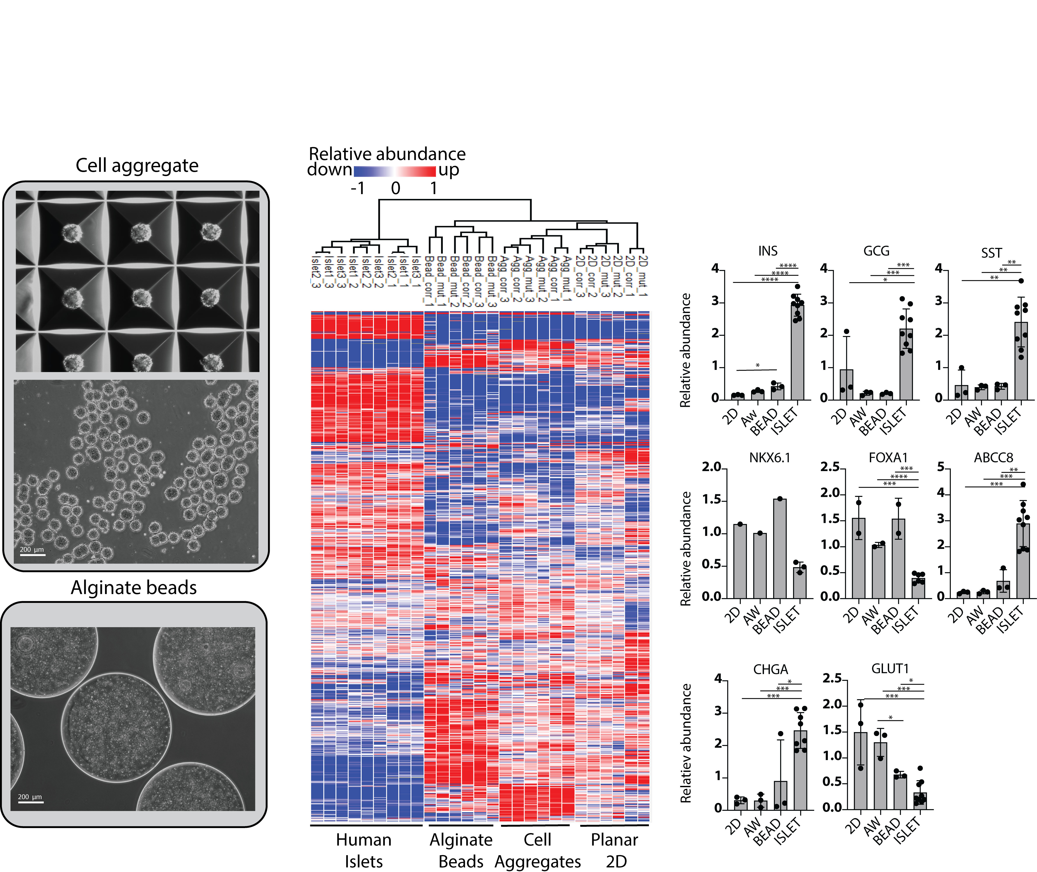
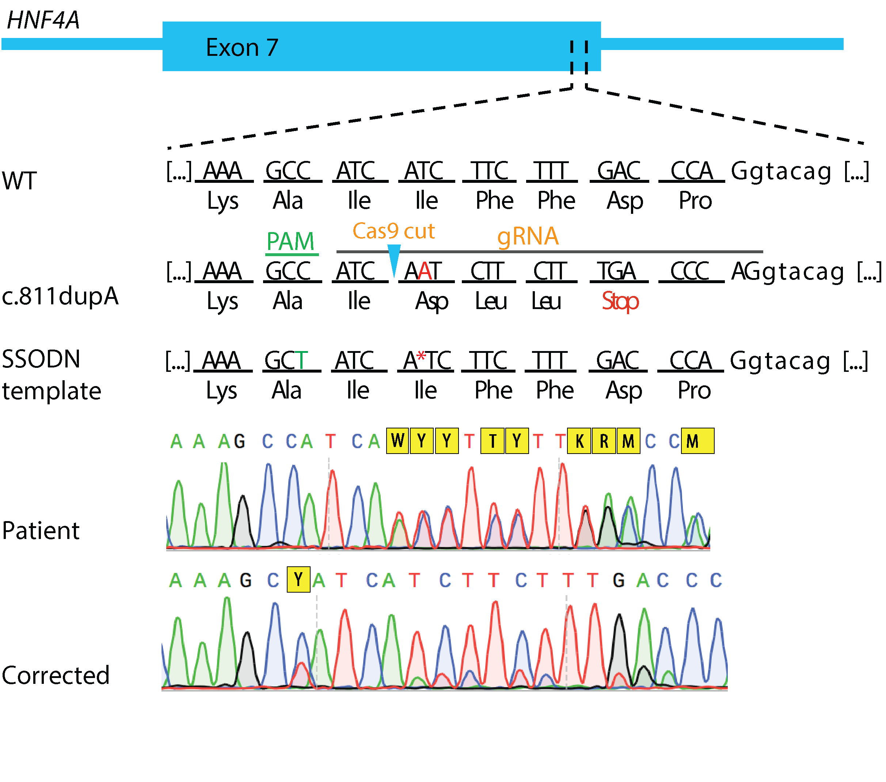

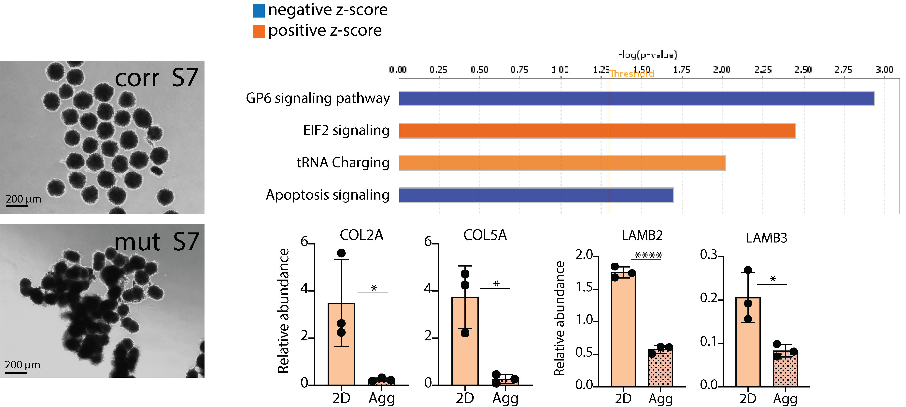
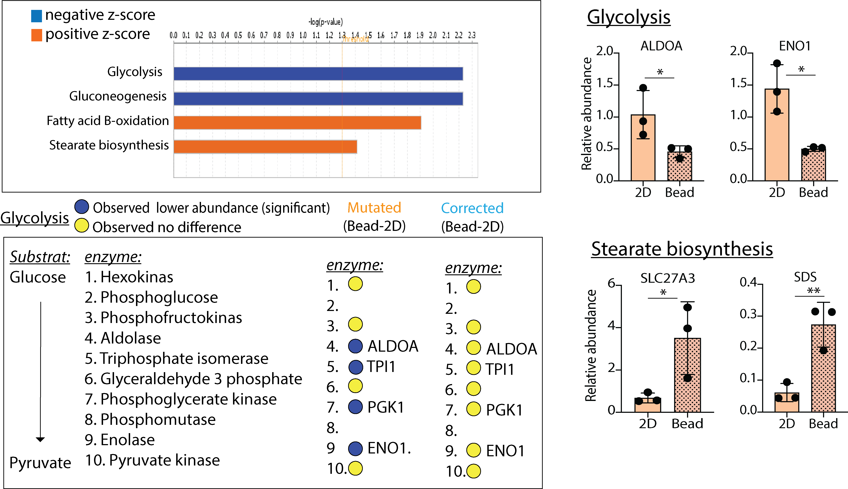
Gene repair restores aggregation defect and glycolytic capacity
Proteomics:
Clustering analysis
Homologous directed repair (HDR) CRISPR/Cas9
Size-adjusted cell aggregates
Carasco et al, unpublished
Notes:
We performed homolo.
The correction was validated by sanger seq.
The twi 3D environment…
By global proteomics, We compared the S7 cells in the two 3D formats with negative and positive control. The negative control was cells differentiated in 2D all the way, while the positive control was human islets. The heat map analysis revealed four major clusters. Then we noticed that the clusters represented the methods This told us theta the 3D environment during diff has a huge impact on the cells.
Next we compared how the mutated cells and the corrected cells responded to the two 3D environments and we could identify mutation specific effect in both 3D formats.
c.811
Heat map: fist what we see (clusteres), then we noticed methods,,which could mean the conclusion.

Slide 18
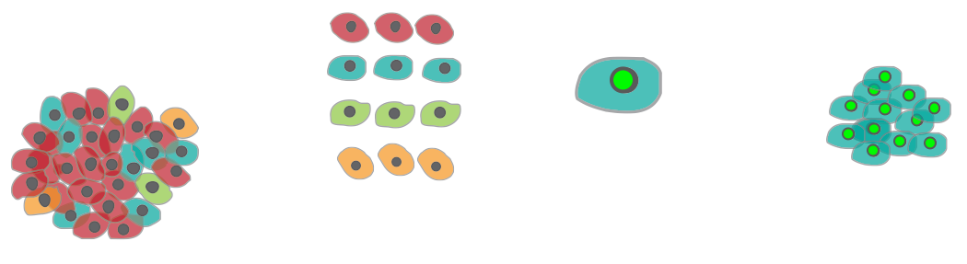

Repurposing alpha-cells to produce insulin by gene therapy?
Nature. 2019 Mar;567(7746)
1. FACS
2. Transduction
3. Aggregation
glucose
insulin
Ad-GFP (αGFP) or
Ad-GFP-PDX1 +
Ad-GFP-MAFA (αPM)
Monotypic
pseudoislets
Glucose-responsive insulin-producing alpha-cells
Donor islets
Notes:
Cell-identity switches, in which terminally differentiated cells are converted into different cell types when stressed,
represent a widespread regenerative strategy in animals, yet they are poorly documented in mammals. In mice, some
glucagon-producing pancreatic α-cells and somatostatin-producing δ-cells become insulin-expressing cells after the
ablation of insulin-secreting β-cells, thus promoting diabetes recovery. Whether human islets also display this plasticity,
especially in diabetic conditions, remains unknown. Here we show that islet non-β-cells, namely α-cells and pancreatic
polypeptide (PPY)-producing γ-cells, obtained from deceased non-diabetic or diabetic human donors, can be lineagetraced
and reprogrammed by the transcription factors PDX1 and MAFA to produce and secrete insulin in response to
glucose. When transplanted into diabetic mice, converted human α-cells reverse diabetes and continue to produce
insulin even after six months. Notably, insulin-producing α-cells maintain expression of α-cell markers, as seen by
deep transcriptomic and proteomic characterization. These observations provide conceptual evidence and a molecular
framework for a mechanistic understanding of in situ cell plasticity as a treatment for diabetes and other degenerative
diseases.

Slide 19
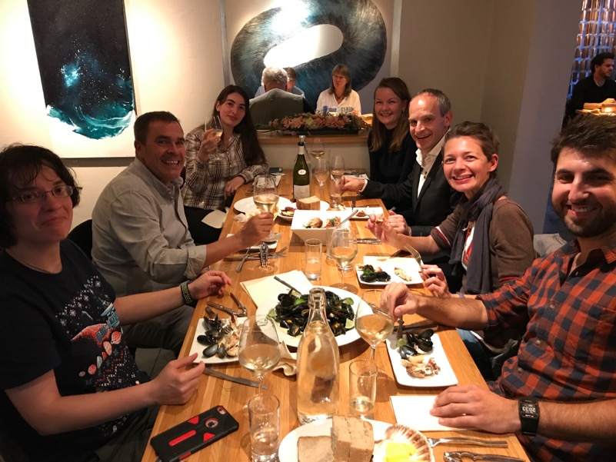



Acknowledgements
University of Geneva, CH
Pedro Herrera
Harvard Medical
School, US
Steve Gygi
Joao Paulo
U Birmingham
Jan Idkowiak
U Tokyo
Beate Heissig
Cell Transplantation Research
and the Islet Isolation Facility, Oslo, NO
Hanne Scholz
U Bergen
Stefan Johansson, Pål Njølstad
Eivind Husebye, Obaidur Rahman
Kamal Mustafa, Hassan Ali
Ketil Ødegård, Novin Balafgan
Thomas H + Mariann B
Heidrun Vethe
Luiza Ghila
Pedro Herrera
Laurence Hoareau
Simona Chera
Manuel Carrasco
Yngvild Bjørlykke
Anne Mette Søviknes
Notes:
So with that I would like to thank........
Finally i want to thank my funders, collaborators and my research group.
My PhD student Heidrun, present here, did a wonderful job with the reprogramming, targetted differentiation and proteomics work, the latter in collaboration with the Gygy lab at HMS during here stay here and the PROBE proteomics lab in Bergen.
Luiza assisted with the immunos, and Simona with the bioinformatics analysis, also assisted by Harald Barsnes at Probe.
Yngvild did the hiPSC characterization and MRM assays
Hanne Scholz in Oslo provided islets.
With that I am happy to take questions.

