Slide 1


German Institute for Economic Research – DIW Berlin
European gas markets between Ukraine war today and climate neutrality in the future
International VISTA Seminar @ Norwegian Academy of Sciences
Franziska Holz,
joint research with Ruud Egging, Konstantin Löffler, Christian Hauenstein, Christian von Hirschhausen, Pao-Yu Oei, Claudia Kemfert and others

Slide 2
Main messages
Natural gas has played a large role in many European countries and the medium-term outlook does not foresee a major change.
Thanks to large import capacities, European importers can cope with Russian shortfalls in 2022 and in the next years by increasing imports from elsewhere while only modestly reducing their consumption.
The effect of climate policy for natural gas is yet uncertain – in Europe and globally.

Slide 3
The EU‘s dependency on (Russian) fossil fuel imports (2020)
Import dependency: 84%
Import dependency: 97%
Import dependency: 36%
Since February 2022: reduction of imports from Russia

Slide 4
Russia‘s role in gas supplies was larger in CEE & Germany
Source: own calculations based on Eurostat, cf. Holz, Kemfert et al. (2022, DIW Aktuell 81)

Slide 5
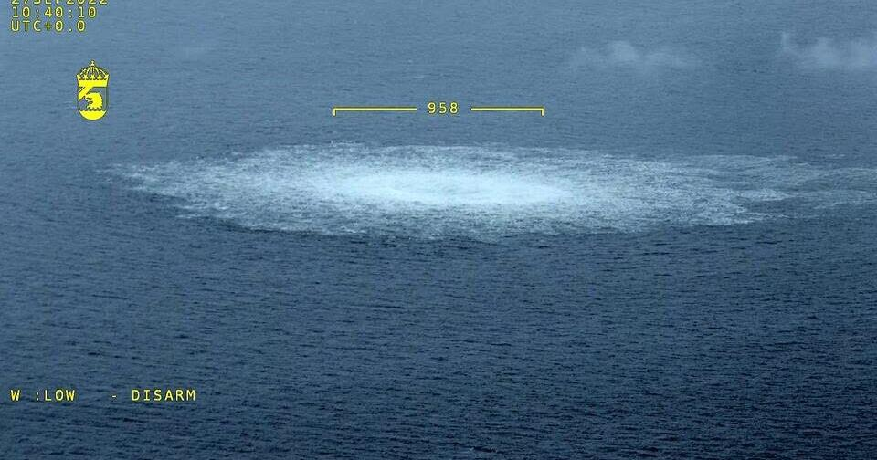
Nordstream 1 and 2: End of massive Russian exports to Europe
26.9.2022: Explosions in NS1 and NS2 pipelines
Ukrainian transit and Yamal-Europe pipeline via Poland are still open and available
Only Ukrainian transit is still used, but for very small volumes

Slide 6
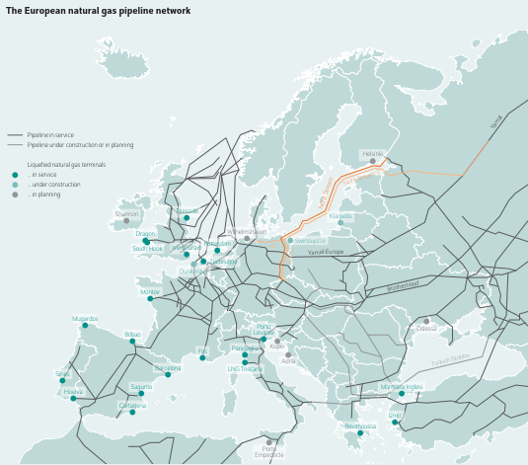
European natural gas pipeline infrastructure very dense, but originally built around the backbone of Russian exports westwards
Figure: cross-border pipeline capacities into and within Europe
Source: DIW Weekly Report 27-2018

Slide 7
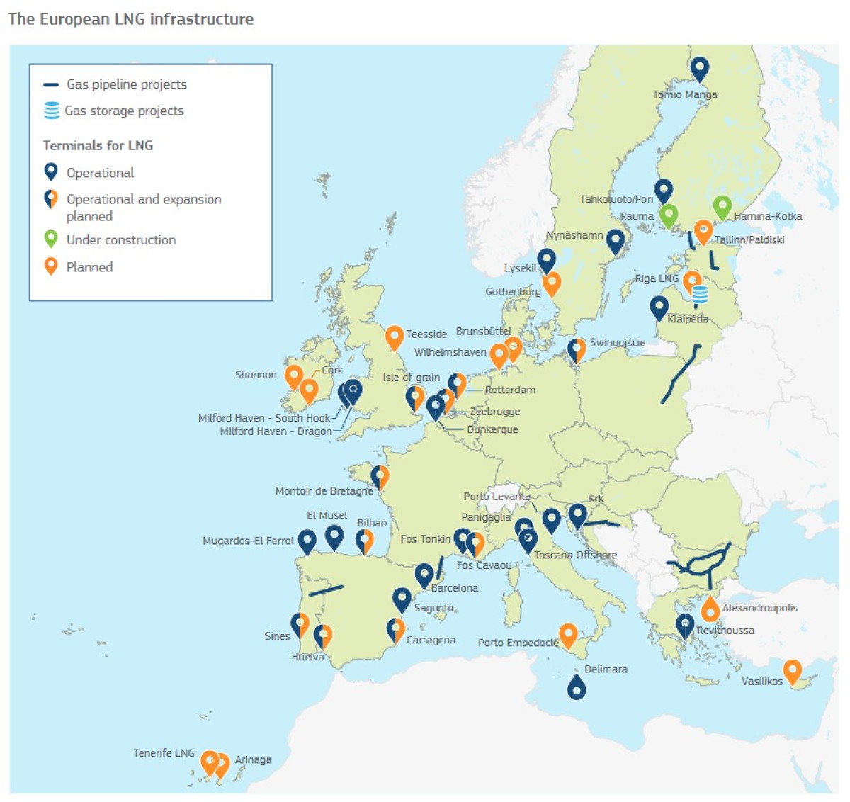
2022: A boom of new LNG import terminal projects in Europe
Source: CleanEnergyWire
Until 2021: Already large EU LNG import capacities of ~200 bcm, now an additional ~ 50 bcm/a capacity planned
Region | Pipeline | LNG
Europe imports | 78% | 22%
Asia imports | 14% | 86%
Global | 54,3% | 45,7%
Source: BP 2019
→ Most EU imports traditionally arrive via pipeline

Slide 8
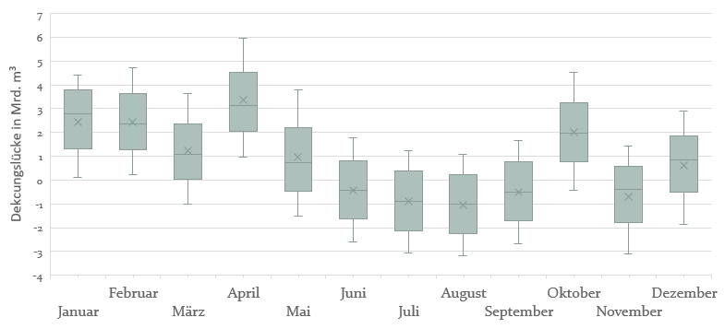
Strong dependency on Russian imports in Germany
Supply gaps in winter months in Germany if Russian natural gas exports cease
Anmerkungen: Heizperiode mit Ausspeicherung (d.h. Netto-Rückgang des Speicherfüllstandes) zwischen Dezember und März; April bis November Einspeicherung (d.h. Netto-Erhöhung des Speicherfüllstands)
Figure: Box plot of German supply gap taking into account various scenarios for storage rules and alternative supplies

Slide 9
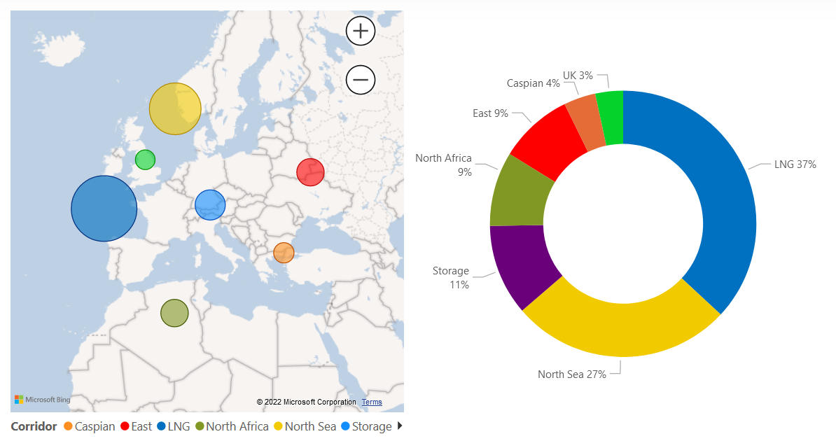
The new reality: European supplies relying on Norway and … LNG
20 November 2022
Source: https://gasdashboard.entsog.eu/

Slide 10
Europe in a global competition for (U.S.) LNG
Only with Russian disruption or subsidized LNG transport to Europe would the EU import (U.S.) LNG
North American exports and their destination regions in selected scenarios 2020-2050, in bcm per year
Note: The numbers succeeding the scenario name indicate the applied percentage of the Base Case cost data (i.e., the opposite of the subsidy rate). In the Altmaier and Jinping scenarios, the first number refers to the operational costs; the second number refers to the investment costs in regasification capacity. In the Trump scenarios, the number is the share of Base Case LNG transportation costs between U.S. liquefaction and European regasification nodes. E.g., “100” means 100% of the Base Case cost, hence, a 0% subsidy on the costs.
Source: „Freedom gas to Europe?“ (Egging-Bratseth et al., RIBAF, 2021)
Notes:
In the Base Case, Europe absorbs less than 20% of the U.S. LNG exports in all time periods.
In the Putin scenario, Europe can pull up to 60% and in the full subsidy Trump scenario even up to 80% of the U.S. LNG exports.
In all other scenarios, Asia largely dominates the LNG imports from the USA (and all other sources) and absorbs two thirds or more.

Slide 11
U.S. LNG to Europe
Model results tell us about LNG spot markets today
Russian disruption („Putin“) has strong effect on EU LNG imports
High subsidy levels („Trump“) considerably increase EU LNG imports
Hardly any influence of Altmaier scenario
Hardly any influence of Jinping scenarios
Small base case volumes
LNG exports from the U.S. to various destinations in Europe in the Base Case and selected scenarios in bcm/year
Note: The numbers succeeding the scenario name indicate the applied percentage of the Base Case cost data (i.e., the opposite of the subsidy rate). In the Altmaier and Jinping scenarios, the first number refers to the operational costs; the second number refers to the investment costs in regasification capacity. In the Trump scenarios, the number is the share of Base Case LNG transportation costs between U.S. liquefaction and European regasification nodes. E.g., “100” means 100% of the Base Case cost, hence, a 0% subsidy on the costs.
Source: „Freedom gas to Europe?“ (Egging-Bratseth et al., RIBAF, 2021)
Notes:
Trump 000 also makes Croatia LNG terminal attractive

Slide 12
LNG terminals in Germany?
Only with subsidies or Russian disruption and…
Mix of LNG suppliers
… with Norway as pivotal supplier
German LNG imports from the U.S. in different scenarios in bcm per year
Note: The numbers succeeding the scenario name indicate the applied percentage of the Base Case cost data (i.e., the opposite of the subsidy rate). In the Altmaier scenarios, the first number refers to the operational costs; the second number refers to the investment costs in regasification capacity.
Germany Supply Breakdown in the Base Case and selected scenarios in bcm/year
High subsidies for LNG terminals in GER
Russian disruption

Slide 13
The role of LNG in Europe past and present
LNG exports to the EU (inkl. UK) 2010–2021, in bcm per year
Source: BP Statistical Review of World Energy (2011, 2016-2022)
Until ~ 2020:
Small share of total LNG imports (< 25%)
Main problem: pipeline transport from LNG import terminals to consumers across Europe
National natural gas markets in Europe still quite segmented
However, hub development in some places has increased liquidity and made these markets attractive to LNG suppliers, in particular TTF in NW-Europe
2022: USA (44%), Russia (17%), Qatar (13%)
Source: European Commission

Slide 14
Natural gas demand in climate-friendly pathways: uncertain in the short run but decreasing in the long run
Source: Egging et al. (2019, www.set-nav.eu)
50% - 75% decrease
Import dependency decreases,
potentially further accentuated by RES-gas (hydrogen, synthetic methane)
14

Slide 15
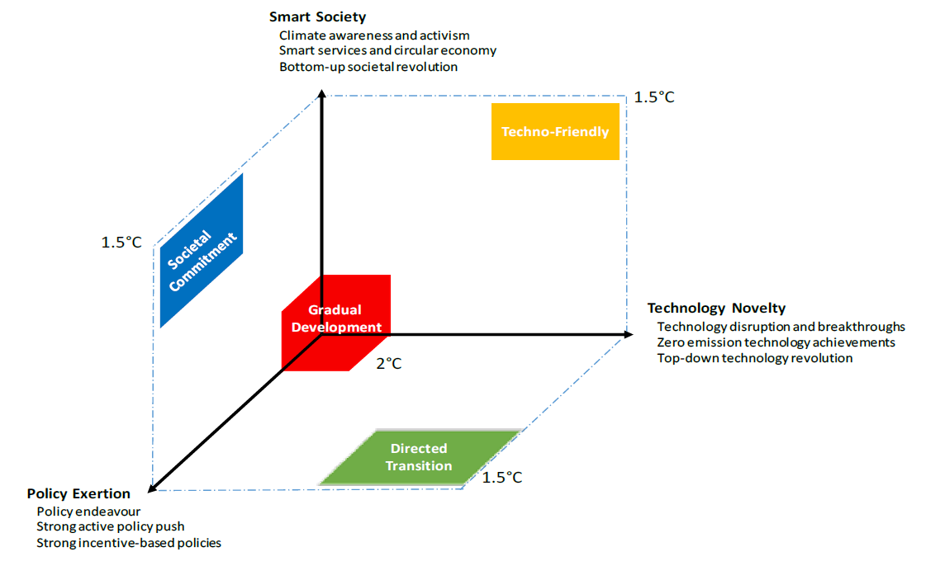
The openENTRANCE scenarios: very ambitious, Paris-compatible climate targets
Source: https://openentrance.eu

Slide 16

Gas will continue to play a role until the 2030s
1.5°C 2°C 1.5°C 1.5°C
Figure: European primary energy demand until 2050 in openENTRANCE scenarios (Deliverable 3.2)
https://openentrance.eu/2021/04/27/genesys-mod-tu-berlin/
https://github.com/open-modex/model_GENeSYS-MOD
https://git.tu-berlin.de/genesysmod/genesys-mod-public/-/releases/genesysmod3.0

Slide 17
Phase-out of fossil fuels will achieve EU emissions reduction
1.5°C 2°C 1.5°C 1.5°C
Figure: Total annual emissions per sector (top) and energy carrier (bottom) until 2050 in openENTRANCE scenarios (Deliverable 3.2)

Slide 18









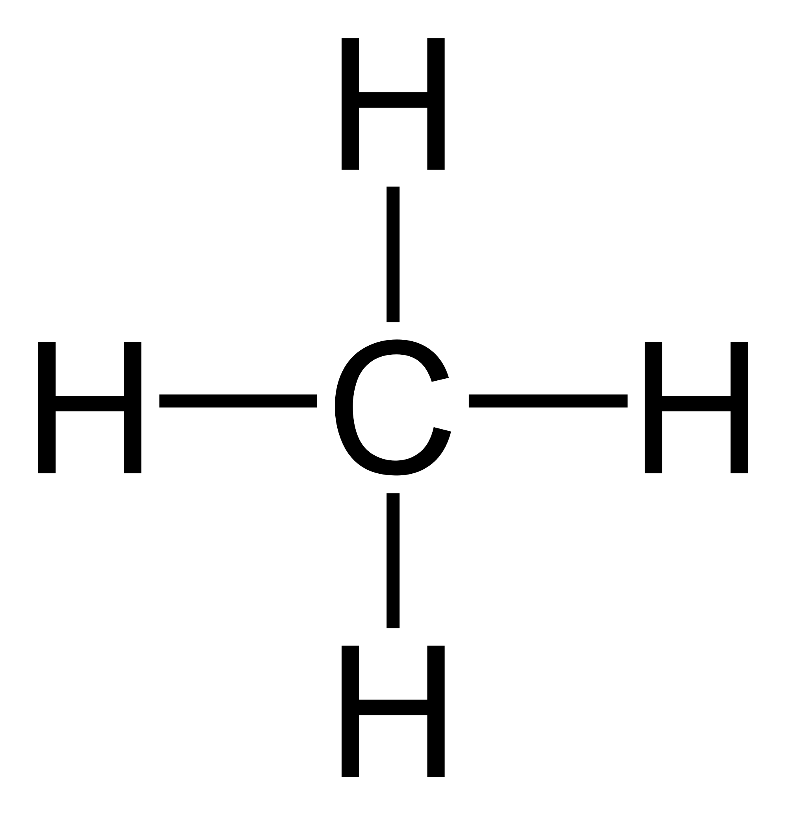

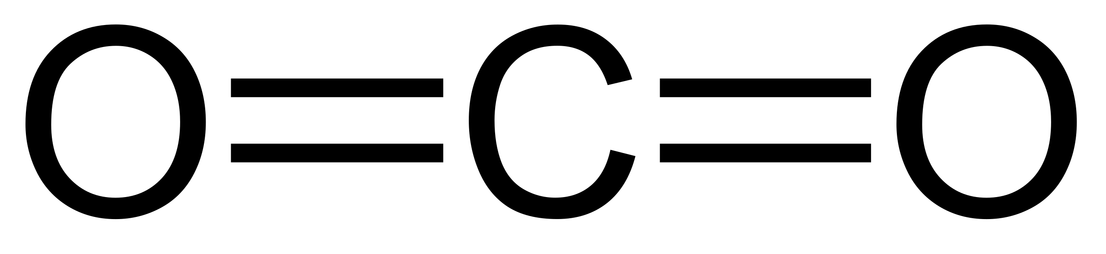
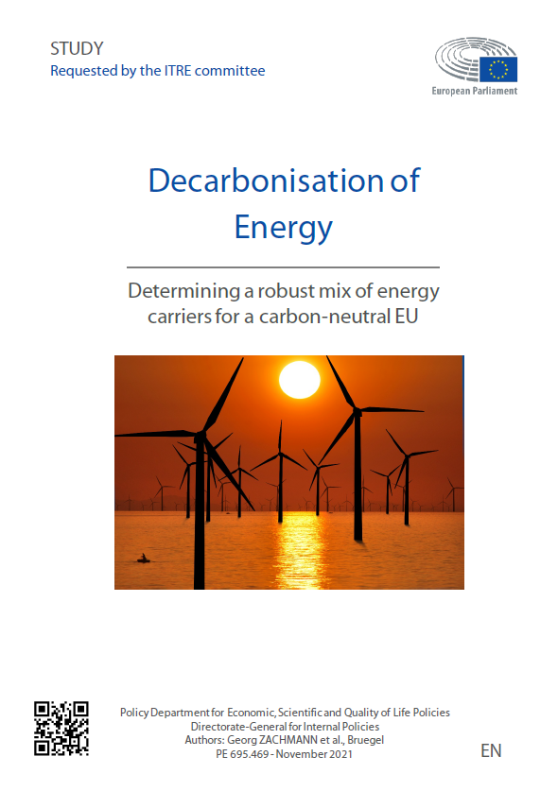
A possible future European energy system without fossil fuels
Electricity generation
Electricity
Power grid
Hydrogen
Hydrogen grid
H2
H
65%
H
Methanation
Carbon dioxide
Synthetic Methane
Gas grid
Source: „Decarbonisation of energy“ (2021, study for the European Parliament)

Slide 19
Main replacement for natural gas: electricity
1.5°2° 1.5°1.5°
1.5°2° 1.5°1.5°
1.5°2° 1.5°1.5°
1.5°2° 1.5°1.5°
Figure: Electrification rate per sector and scenario until 2050 in openENTRANCE scenarios (grey line represents annual average) (Source: Deliverable 3.2)

Slide 20
Conclusions
Natural gas has played a large role in many European countries and the medium-term outlook does not foresee a major change.
Thanks to large import capacities, European importers can cope with Russian shortfalls in 2022 and in the next years by increasing imports from elsewhere, notably Norway and LNG, while only modestly reducing their consumption.
The effect of climate policy for natural gas is yet uncertain – in Europe and globally.

Slide 21
Prof. Dr. Franziska Holz

